Slide 1
TWITTER US AIRLINE SENTIMENT
Dexiang Xu
Gaoyang Ye
Liang Shi
Mengheng Hu
Yue Sun

Slide 2
Summary of Problem

Slide 3
Description of input data

Slide 4
Algorithm and pseudocode

Slide 5
Big Data strategy

Slide 6
Data flow

Slide 7
Original Data Set Analysis

Slide 8
Objective
In this part we were focusing on the original data set, trying to retrieve the insight of the data. What information can we obtain from the data set

Slide 9
Techniques
1. Apache Pig
2. Hadoop MapReduce
3.Tableau

Slide 10
Data file loading in
Group by attributes
Filter records
Count each records

Slide 11
Sample questions are like:
overall sentiment(negative, neutral, positive percentage)
percentage of tweets per airline
Proportion of negative, neutral and positive sentiment tweets per airline
Reasons for negative sentiment tweets
Reasons for negative sentiment per airline
Tweet location exploration
Tweet time zone study

Slide 12
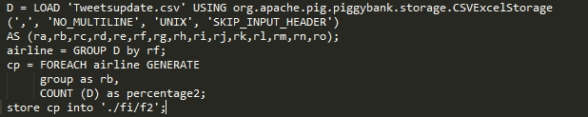
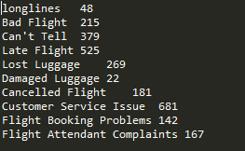
Sample Code
Results

Slide 13
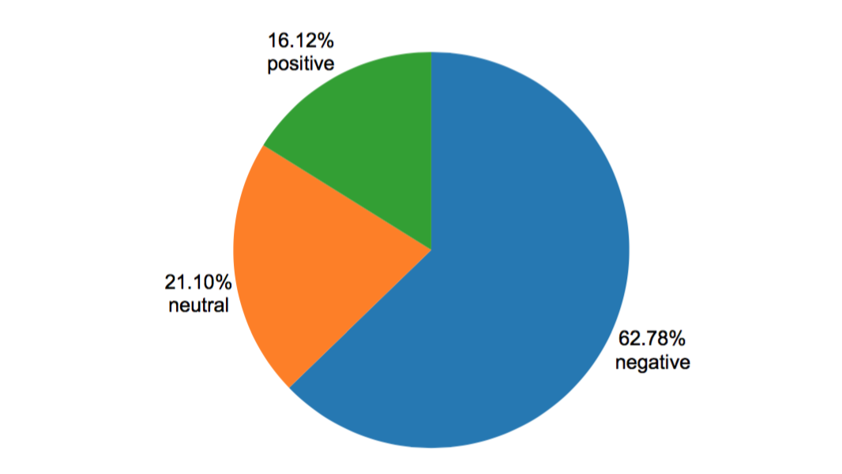
overall sentiment analysis

Slide 14
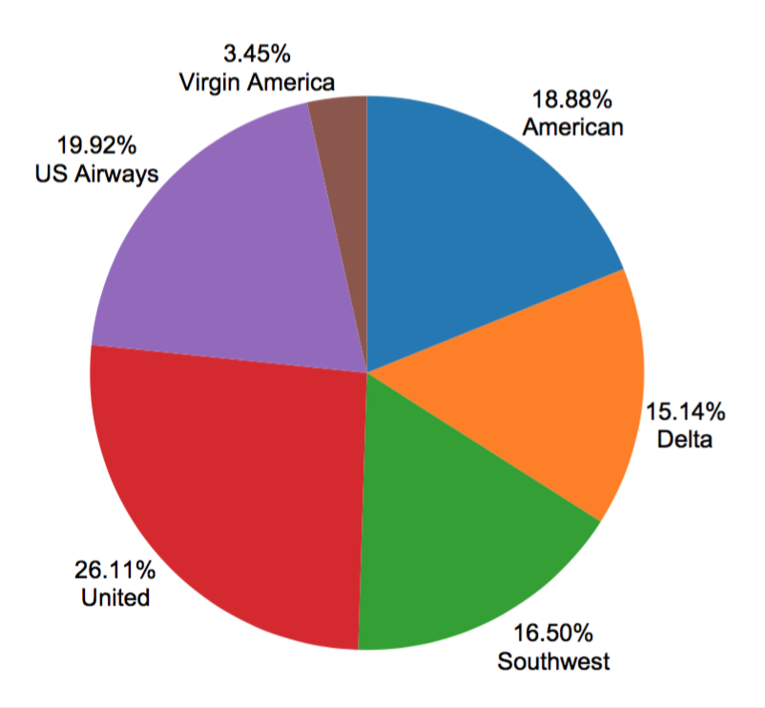
Percentage of tweets per airline

Slide 15
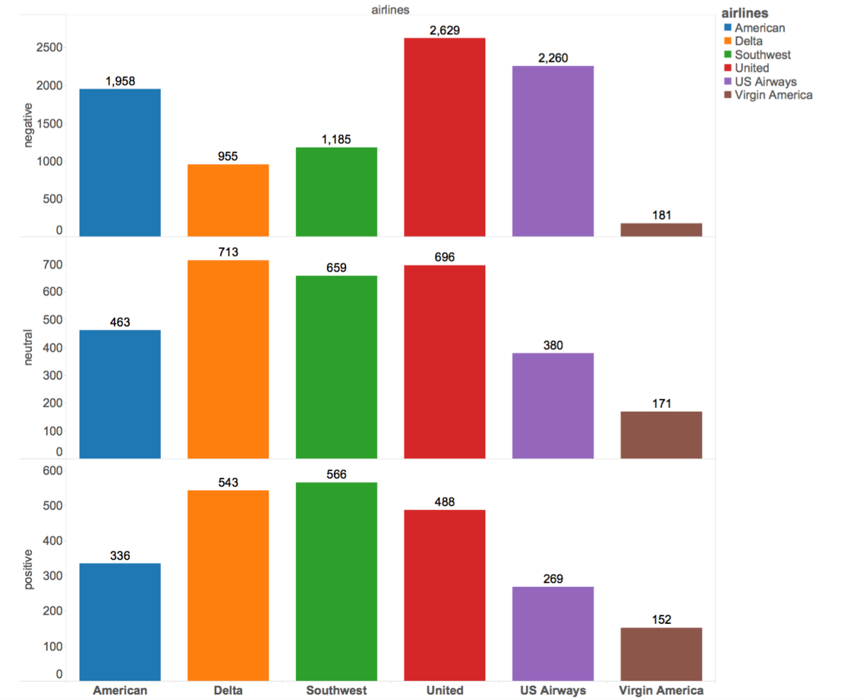
negative, neutral positive sentiment tweets per airline

Slide 16
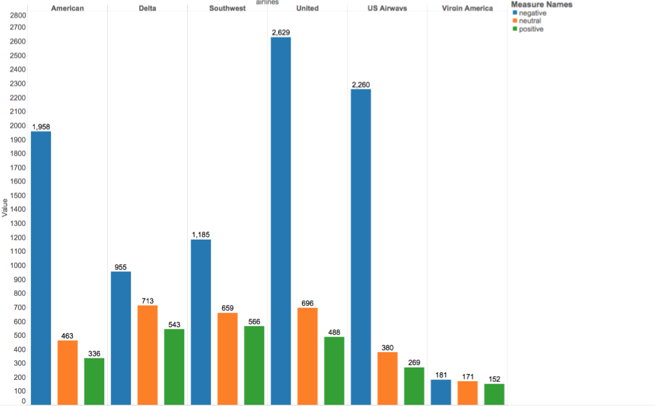
negative, neutral positive sentiment tweets per airline 2

Slide 17
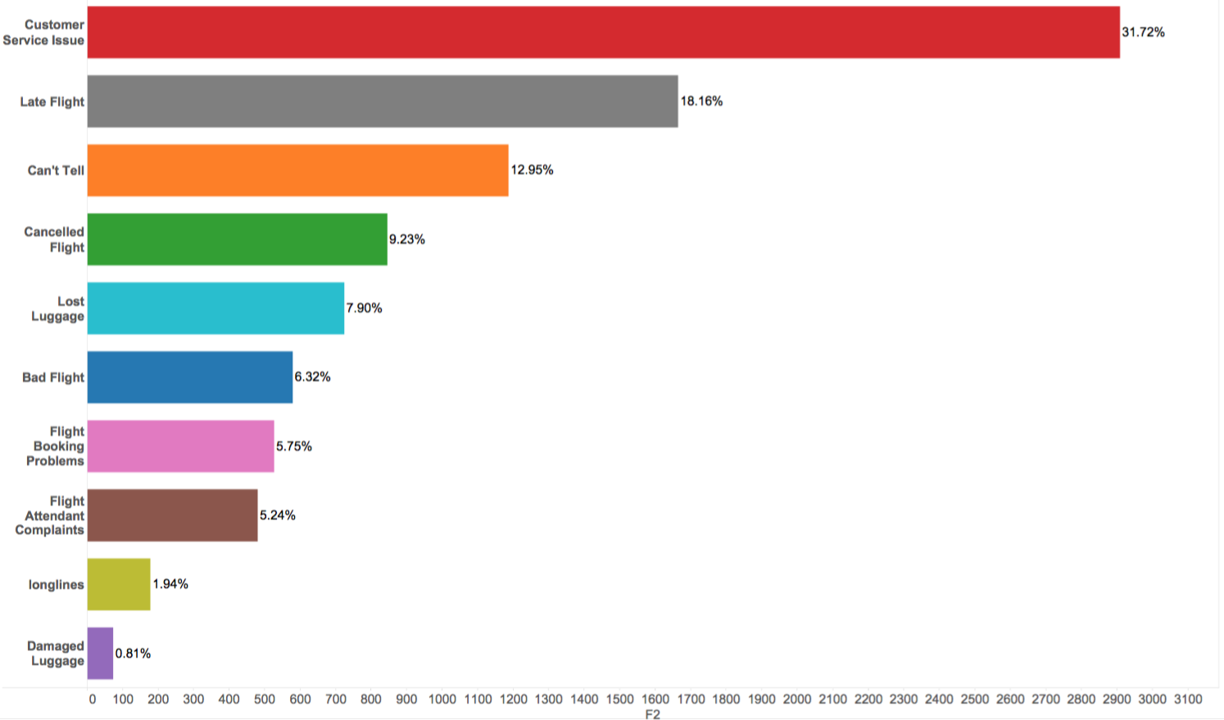
Negative sentiment

Slide 18
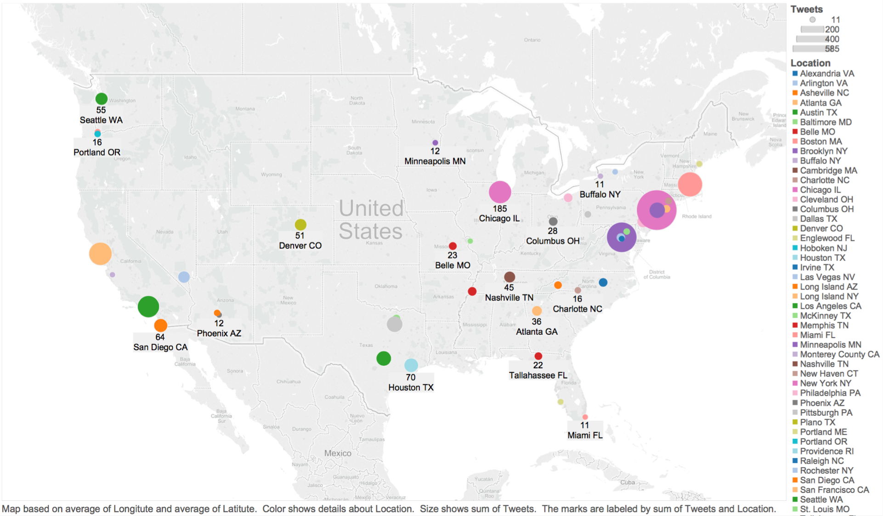
Location Visualization

Slide 19
MapReduce part
Objective of this part:
1 Find top 300 negative words in the negative comments in decreasing order
2 Find top 300 positive words in the positive comments in decreasing order
3 Choose 5-10 from top negative words, find their top 100 co-occurrence words in negative comments.
4 Choose 5-10 from top positive words, find their top 100 co-occurrence words in the positive words

Slide 20
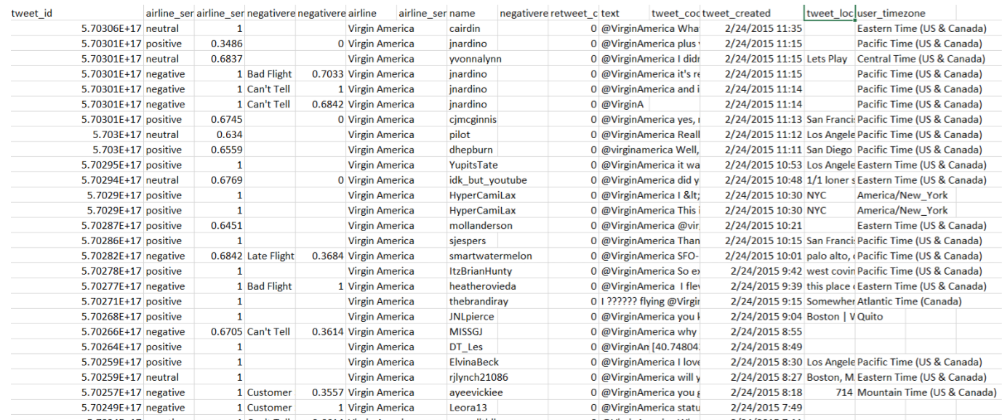
Input Data

Slide 21
Output in tables
 | Top 1 |  | Top 2 |  | Top 3 |  | Top 4 |  | Top 5
customer | service | 538 | United | 289 | For | 260 | USAirways | 241 | AmericanAir | 224
delayed | Flight | 258 | United | 163 | My | 135 | USAirways | 123 | JetBlue | 75
flight | United | 886 | Cancelled | 747 | USAirways | 745 | AmericanAir | 690 | SouthwestAir | 589
help | Air | 230 | USAirway | 214 | United | 207 | Flight | 202 | Helpful | 202
hold | Airways | 275 | Flight | 170 | Been | 179 | Cancelled | 120 | Hour | 109
service | Customer | 538 | United | 307 | USAirways | 259 | You | 229 | Flight | 156
time | United | 259 | Flight | 232 | USAirway | 218 | My | 217 | AmericanAir | 168

Slide 22
Positive
 | Top 1 |  | Top 2 |  | Top 3 |  | Top 4 |  | Top 5
best | Southwestair | 52 | Jetblue | 37 | My | 37 | Flight | 29 | Airline | 28
customer | Service | 400 | United | 263 | For | 260 | You | 239 | Your | 199
great | Flight | 61 | Jetblue | 55 | Southwestair | 52 | Airways | 47 | United | 46
love | Southwest | 83 | Jetblue | 56 | Would | 38 | Me | 35 | Airline | 35
thank | Thanks | 553 | United | 213 | Airline | 216 | JetBlue | 153 | USAirways | 141
thanks | United | 134 | Air | 117 | JetBlue | 114 | Service | 34 | Time | 26
service | Customer | 538 | United | 307 | Usairways | 259 | You | 229 | Americanairline | 225

Slide 23
Algorithm and approaches
1 remove the stop words, accelerate the process by using hash set, which can determine weather the word is stop word in O(1) time
2 in the map part, analysis each line of tweets, in Task 1, we only analysis and emit the negative comments, correspondingly, in Task 2, we only analysis and emit the positive part.
3 in the reduce process, define a sorter in the combine part which can sort result by our defined method, specially value here.

Slide 24
Machine Learning
Objective: find the best machine learning model which have the accuracy when predict the tweets sentiments?

Slide 25
Data preprocess
Build a matrix of word bag for each tweets with class label, and we could directly use the matrix to train the models

Slide 26
Bag of Words
The bag-of-words model is a simplifying representation used in natural language processing and information retrieval (IR).
Go through all the data, and create a dictionary
Go through the data again, for each tweet, count the words frequency in the order of dictionary W.
Use this matrix as our training data.

Slide 27
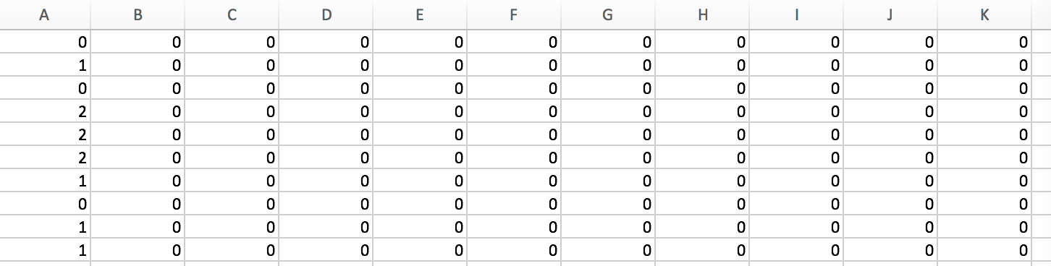
Word bag matrix
Each row represents the word frequency of each tweets.
Each attributes (column) are the word dictionary in step1
We have over 7000 attributes.

Slide 28
Machine Learning part 1
Objective of this part:
Use spark.mllib package to build different machine learning models including logistic regression, decision trees, random forests, naive Bayes to predict tweets sentiments
Preprocess the class label of original data set, which is 3 class labels including positive, neutral and negative
Again preprocess the class label of original data set, which is 12 class labels this time including positive, neutral and 10 different kinds of negative reasons.

Slide 29
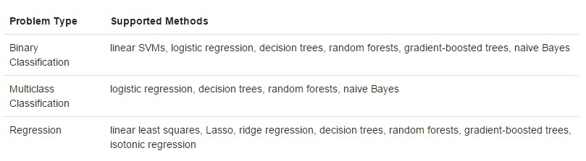
Technique:
The spark.mllib package supports various methods for binary classification, multiclass classification, and regression analysis.

Slide 30
Training/Testing data
Matrix we got from “bag of words” with 3 class label
Matrix we got from “bag of words” with class label
Randomly separate the data in the 70% and 30% into Training and Testing

Slide 31
Logistic regression
Logistic regression measures the relationship between the categorical dependent variable and one or more independent variables by estimating probabilities using a logistic function.

Slide 32
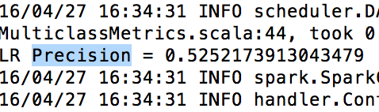
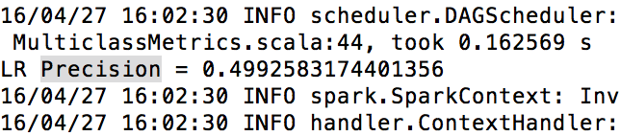
Accuracy of Logistic regression
3 class label
12 class label

Slide 33
Decision trees:
The decision tree is a greedy algorithm that performs a recursive binary partitioning among features. Each partition is chosen greedily by selecting the best split from a set of possible splits, in order to maximize the information gain at a tree node. And the recursive tree construction stopped at a node when it meets specific conditions.

Slide 34
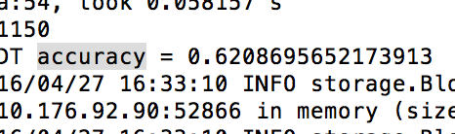
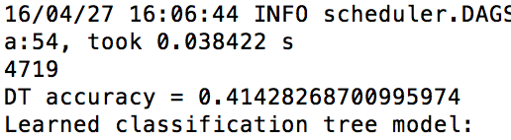
Accuracy of Decision tree
3 class label
12 class label

Slide 35
Random forests
Random forests are ensembles of decision trees. They combine many decision trees in order to gain accuracy while reduce the risk of overfitting.

Slide 36
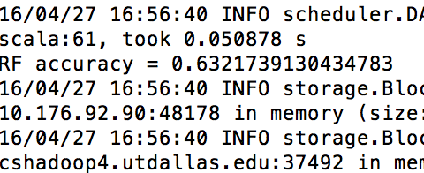
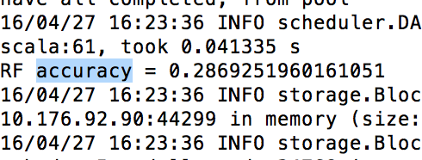
Accuracy of Random forest
3 class label
12 class label

Slide 37
Naïve Bayes:
Naive Bayes computes the conditional probability distribution of each feature given label, and then it applies Bayes’ theorem to compute the conditional probability distribution of label given an observation and use it for prediction

Slide 38
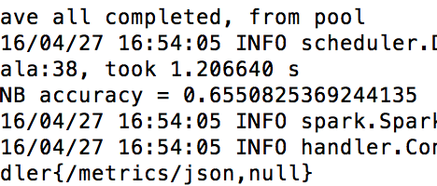
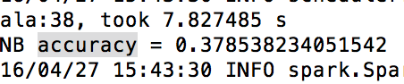
Accuracy of Naïve Bayes
3 class label
12 class label

Slide 39
Conclusion
 | 3 class | 12 class
Decision trees | 0.6207 | 0.4143
Naïve Bayes | 0.6550 | 0.3785
Random forests | 0.6332 | 0.2869
Logistic regression | 0.5252 | 0.4993
significant better result in 3 class labels than that of 12 class labels

Slide 40
Good enough in 3 class label.
Can we do better in 12 class label?

Slide 41
Part 2

Slide 42
What did I do?

Slide 43
Training/Testing data
Matrix we got from “bag of words”
Randomly separate the data in the radio of 6:1(roughly) into Training and Testing

Slide 44


Model
Naïve Bayes
Neural Network

Slide 45
Runtime
Naïve Bayes:
Few seconds
Neural Network:
Around 30 min in one computer
One minute in cluster

Slide 46
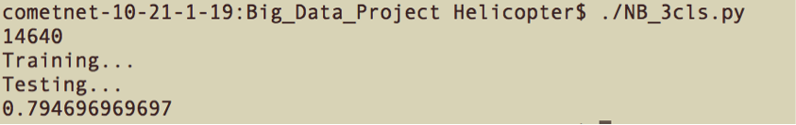
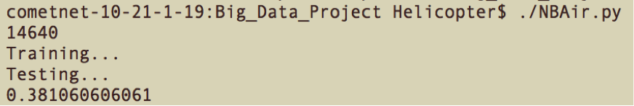
Accuracy
Naïve Bayes:
Three classes: 79.5%
Twelve Classes: 38.1%

Slide 47
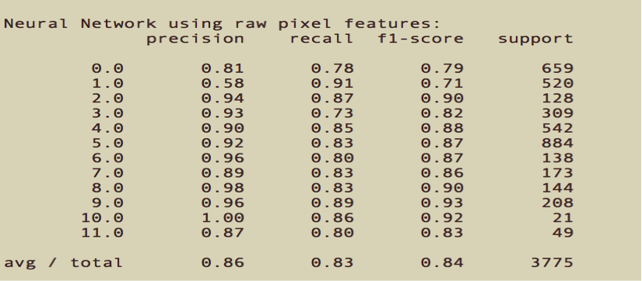
Accuracy
Neural Network:
86% for twelve classes!

Slide 48
Avoiding Overfitting
Scikit-learn package has some inner mechanism to avoid overfitting
Compare result of Spark multilayer perceptron classifier and Scikit-learn package

Slide 49
Questions?

Slide 50
Thank you!

